Slide 1
Software Design and Architecture
Use Cases
Diagrams and Specifications

Slide 2
Use Cases
Use case diagram.
Detailed use case document.

Slide 3
Use Case Diagram
UML artifact(object) to represent the overall system specifications.
Shows system boundary, main functionalities, the external entities which can interact with the system.

Slide 4
Use-case Document
A narrative(store) document that describes the sequence of system events and the system responses originating from the initiating actors of the system.
A use case tells a story of actors using a system
A use-case is a sequence of actions a system performs that yields an observable result of value to a particular actor.

Slide 5
Terms and Concepts
Actor:
  something with behavior, such as a person, computer system, or organization, e.g. a cashier.
Scenario:
  specific sequence of actions and interactions between actors and the system under discussion, e.g. the scenario of successfully purchasing items with cash.

Slide 6
Preconditions:
  Conditions that need to be fulfilled before the use case begins.
Post Conditions:
  State of the system after the use case completes.
Use case:
  a collection of related success and failure scenarios that describe actors using a system to support a goal.

Slide 7
Scenarios
Main success scenario:
  The normal flow of processing
  E.g.,
    A customer arrives at a checkout with items to return. The cashier uses the POS system to record each returned item…
Alternate scenarios:
  If normal flow deviates, then the alternate course of action
  E.g.,
    If the credit authorization is reject, inform customer and ask for an alternative payment method.
    If item identifier not found in the system, notify the Cashier and suggest manual entry of the identifier code.

Slide 8
Types and Formats
Uses cases may be written in three formality types
Brief:
  one-paragraph summary, usually of the main success scenario.
Casual:
  Informal (familiar) paragraph format
Fully dressed:
  elaborate. All steps and variations are written in detail.

Slide 9
Formal description of use cases:
    Use case name
    Actors, brief description
    scenario – flow of events
      Some use cases have multiple scenarios to explore various contingent activities
    Preconditions –before the use case can begin
    Post-conditions: state of system and perhaps for actors, after the use case is completed

Slide 10
Example: Membership Services
Use Case

Slide 11
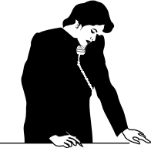
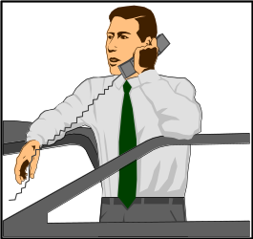


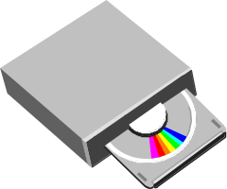

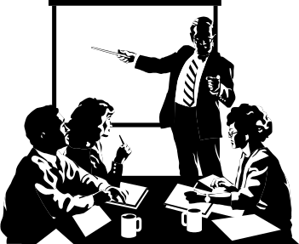
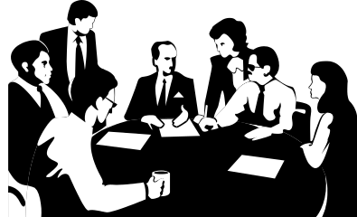
Member Services
Context Model
Club
Member
Subscription Offer
Club promotion
Promotion order
New Subscription
Potential
Member
Past
Member
regular order
Member credit status
Subscription renewal
offer
Subscription renewal
New Membership Plan & Sub. Offer
A/C Receivable DB
Order to be filled
Sales and Promotion Reports
Membership Reports
New Monthly OR Seasonal Promotion
Warehouse
Member Services Dept.
Marketing Dept.

Slide 12
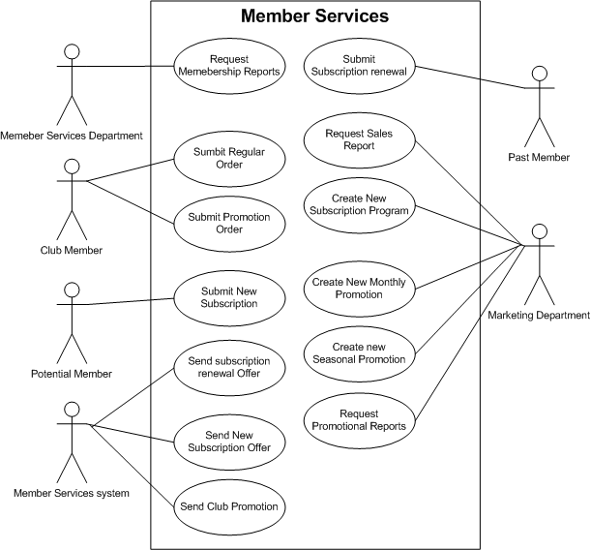

Slide 13
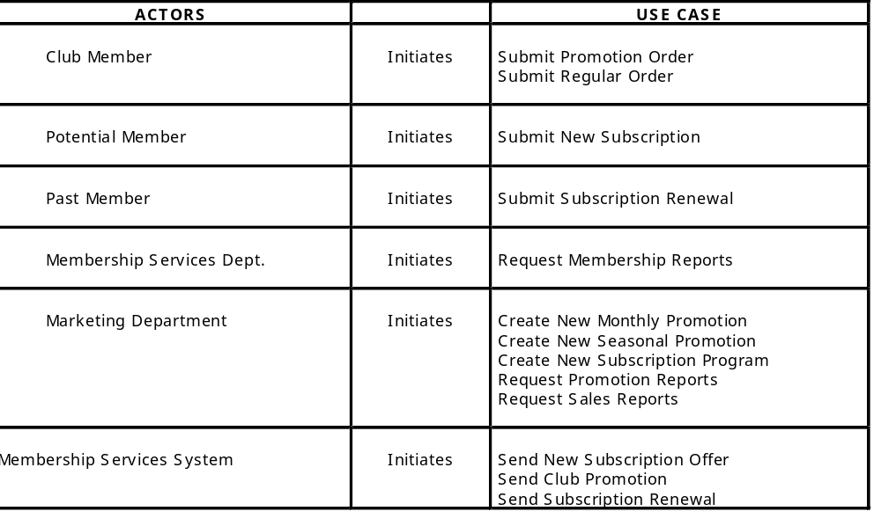

Slide 14
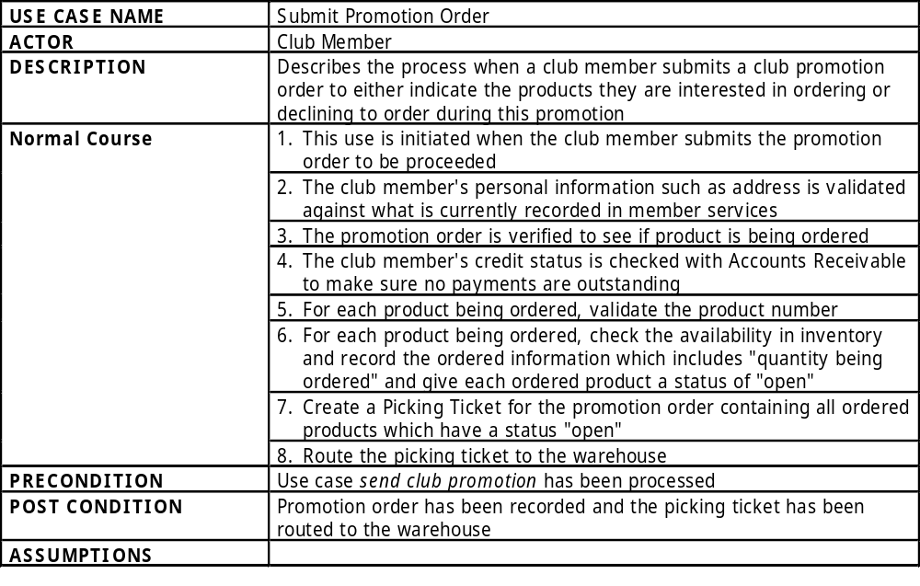

Slide 15
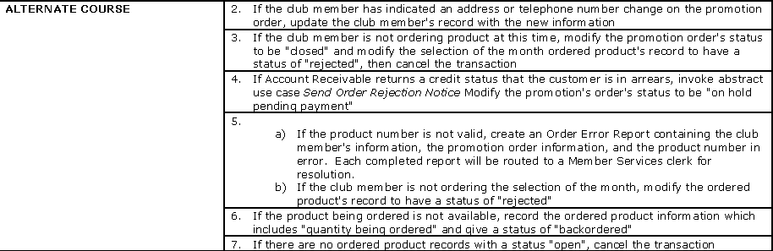

Slide 16
